Slide 1

https://about.chartipedia.com/

Slide 2
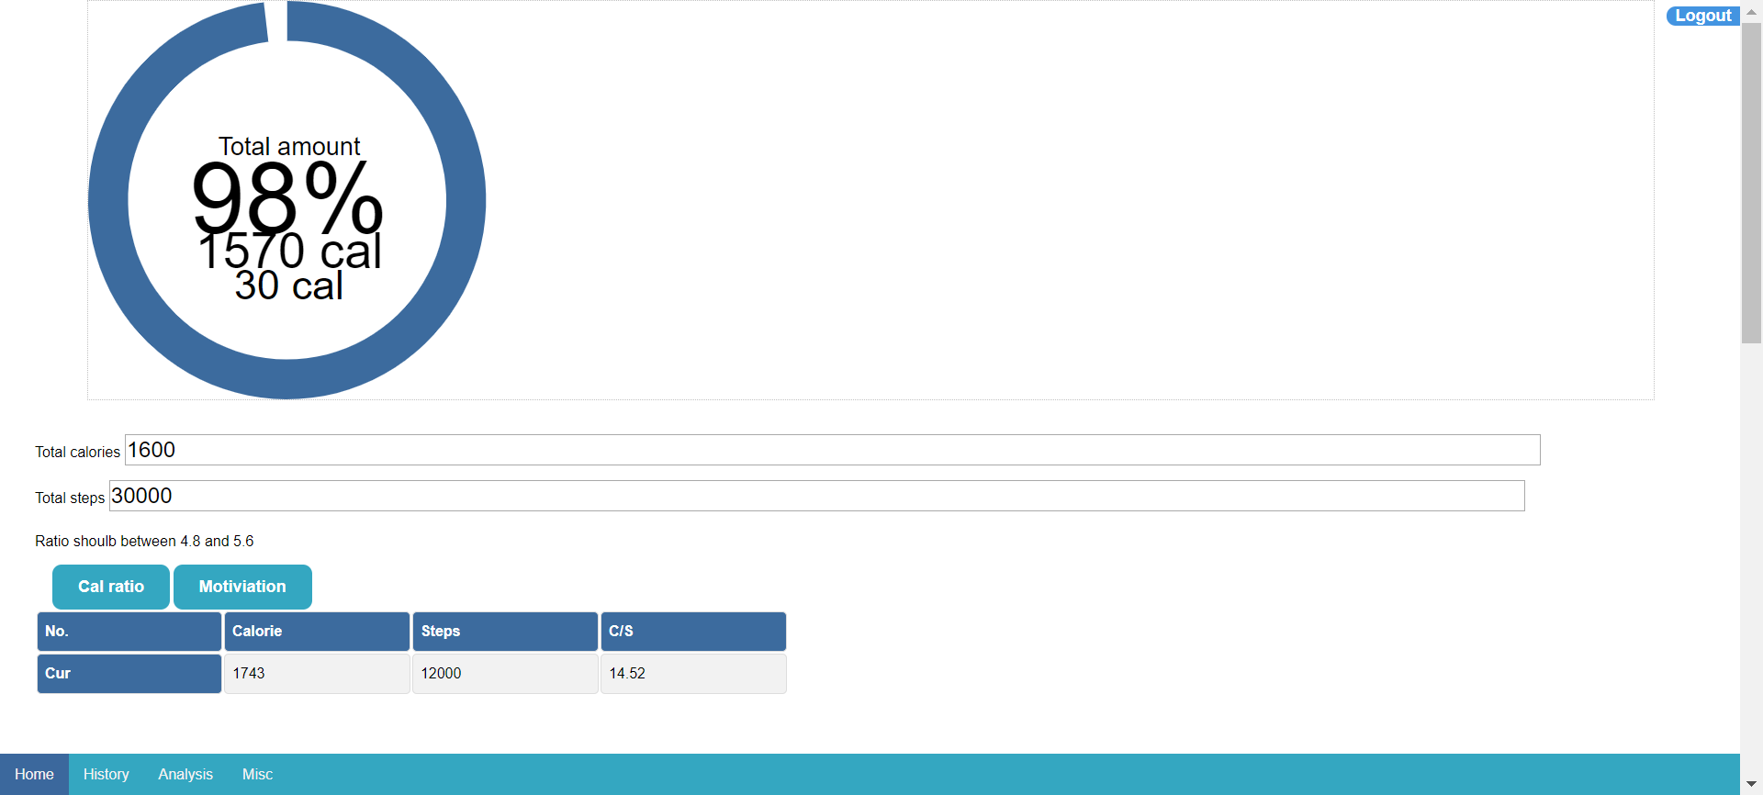

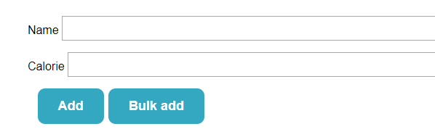


Slide 4
Welcome
https://codepen.io/pen/?&editable=true=https%3A%2F%2Fcodepen.io%2Felectricgarden%2Fembed%2FoNNjbqZ%3Fheight%3D603%26theme-id%3Ddefault%26slug-hash%3DoNNjbqZ%26default-tab%3Dresult%26animations%3Drun%26editable%3D%26embed-version%3D2%26preview%3Dtrue%26user%3Delectricgarden%26name%3Dcp_embed_1

